Slide 1
Multivariate ARIMA Transfer Functions
MARIMA
MARIMA models combine Univariate ARIMA and other Regression models

Slide 2
MARIMA
MARIMA are combined univariate ARIMA and multivariate causal models having the attributes of both Regression and ARIMA models.

Slide 3
MARIMA
One or more independent variables (input variables ) are related to a dependent variable (output variable).
In many applications( business, eco/ sciences), causal relationship exists between a dependent variable and one or more lagged independent variables.
See an introduction of a method to handle such relationships(a basic one at that)

Slide 4
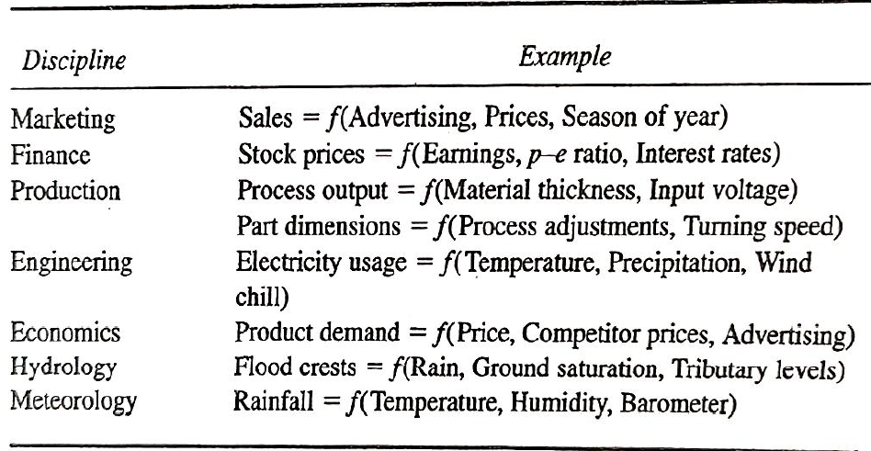
MARIMA

Slide 5
Transfer Functions

Slide 6
MARIMA
Interest: Model a time series Yt as a function of a second time series Xt.
May have considerable autocorrelation and the relationship involving several lags of Yt and Xt.
Plus there can be noise as well
Here both OLS regression and simple ARIMA models are inadequate.
MARIMA model consists of a Transfer Function and a Noise Model.
So MARIMA = Transfer function + Noise model

Slide 7
MARIMA = Transfer function + Noise model
First step is to achieve stationarity in input and output variables.
So x_{t} and y_{t} (stationarity deviations from their mean values) are employed further to model
NB: The lower case notations of x and y
To understand the concept of MARIMA, consider a Simple Linear Regression Model
simple model y_{t} = w_{o} x_{t} + N_{t}
Wo is the regression coefficient (our b) and
N_{t} is the error term

Slide 8
Zero Order Transfer Functions
Consider y_{t} can be forecasted by x_{t-3} and x_{t-4} of lags 3 and 4. ( 3 to 4 period ahead forecasts)
This can be depicted as
y_{t} = w_{o} x_{t-3} – w₁ x_{t-4} + N_{t}
So a general transfer function can be written as
y_{t} = (w_{o} B^{b} - w₁ B^{b+1}+ ……+ w_{s} B^{b+s}) x_{t} + N_{t}
These are extensions of regression models, called Zero Order TF.

Slide 9
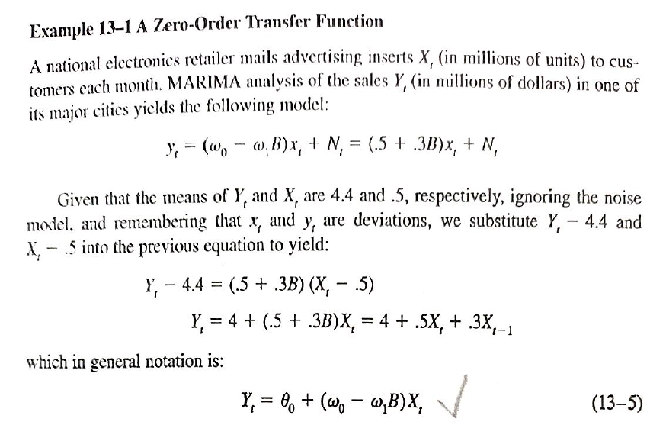
MARIMAA Zero-Order TF

Slide 10
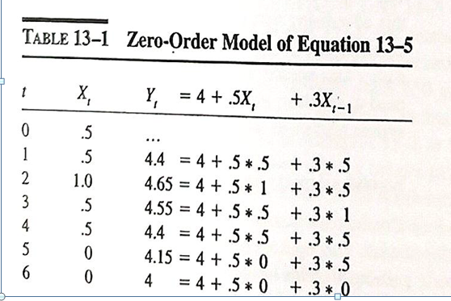
Zero-Order TF: Example
For this Zero-Order TF, the output sales in period t, is influenced by the last two values of the input series.
The ability of TF to model the length of the input’s influence makes them as important dynamic tool.

Slide 11
Pattern End Exam
Pattern PT1 / PT2 ( no sections)
30-30-40
Equal weightage for problems and concepts

